Slide 1
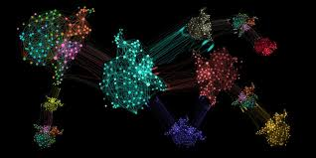
Machin learning clustering
Manikandan P

Slide 2
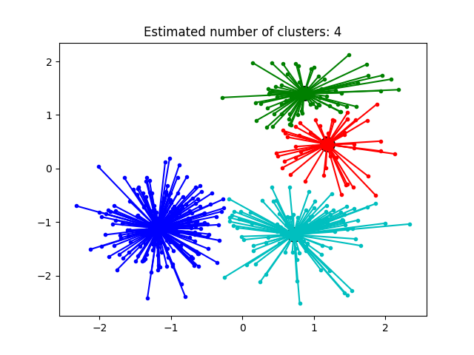
Affinity Propagation
creates clusters by sending messages between pairs of samples until convergence.
A dataset is then described using a small number of exemplars, which are identified as those most representative of other samples
The messages sent between pairs represent the suitability for one sample to be the exemplar of the other, which is updated in response to the values from other pairs.
4.This updating happens iteratively until convergence, at which point the final exemplars are chosen, and hence the final clustering is given
Key Points:
1.Affinitypropagation picks number of clusters based on input data.
2. The main drawback of Affinity Propagation is its complexity. N-number of samples and T- number of iterations until convergence

Slide 3
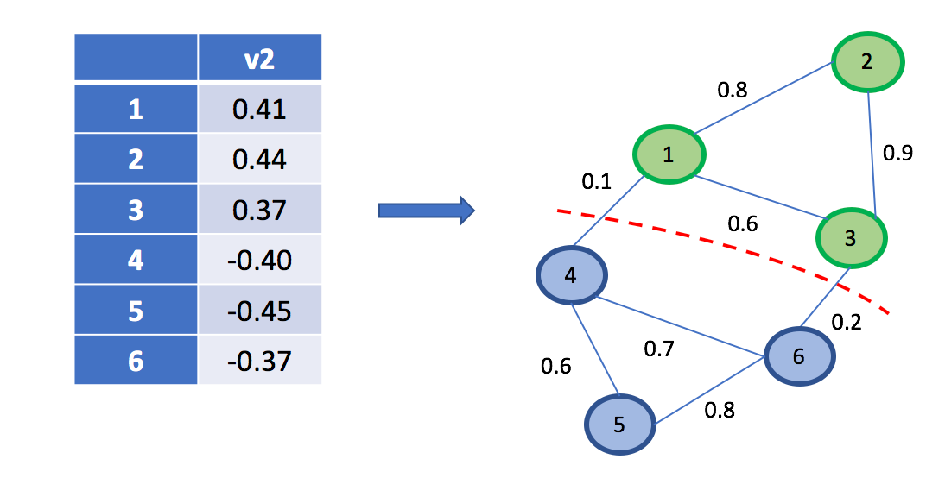
an image with connected circles is generated and spectral clustering is used to separate the circles.
the Spectral clustering approach solves the problem know as ‘normalized graph cuts.
the image is seen as a graph of connected voxels, and the spectral clustering algorithm amounts to choosing graph cuts defining regions while minimizing the ratio of the gradient along the cut, and the volume of the region.
As the algorithm tries to balance the volume ( balance the region sizes), if we take circles with different sizes, the segmentation fails.
In addition, as there is no useful information in the intensity of the image, or its gradient, we choose to perform the spectral clustering on a graph that is only weakly informed by the gradient.
This is close to performing a Voronoi partition of the graph.
Spectral clustering is particularly effective when dealing with non-convex or irregularly shaped clusters. By working in a transformed space defined by the eigenvectors, spectral clustering can capture complex structures in the data.

Slide 4
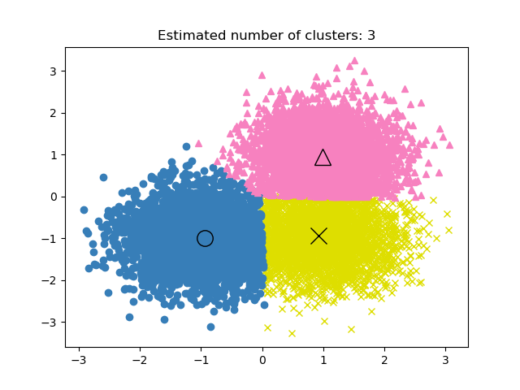
Mean Shift
Mean shift clustering using a flat kernel.
Mean shift clustering aims to discover “blobs” in a smooth density of samples.
It is a centroid-based algorithm, which works by updating candidates for centroids to be the mean of the points within a given region
These candidates are then filtered in a post-processing stage to eliminate near-duplicates to form the final set of centroids.
Seeding is performed using a binning technique for scalability.

Slide 5
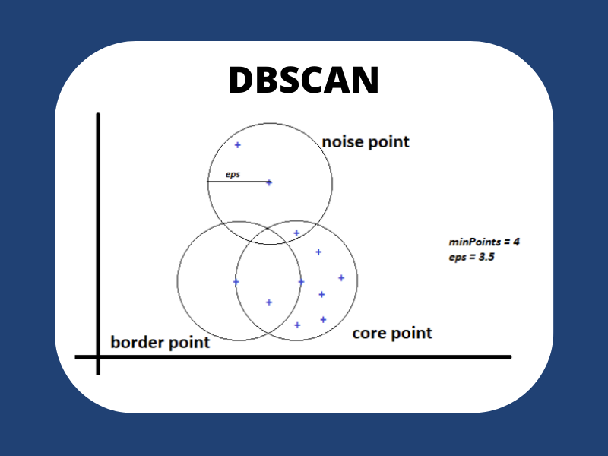
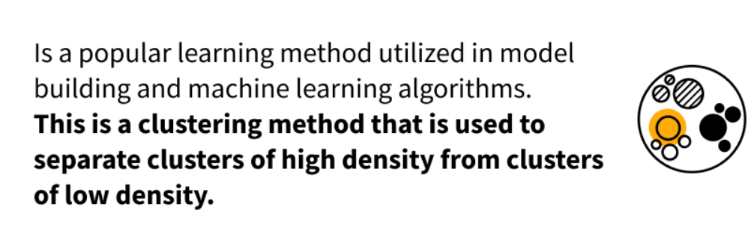
DBSCAN clustering
Density-based: DBSCAN clusters data points based on their density in the surrounding area.
Spatial: DBSCAN considers the spatial relationships between data points.
Noise detection: DBSCAN can identify noise points that do not belong to any cluster.
Parameters: DBSCAN has two main parameters: eps (maximum distance between two points to be considered neighbors) and min_samples (minimum number of neighbors required for a point to be considered a core point).
Scalability: DBSCAN can be computationally expensive for large datasets.

Slide 6
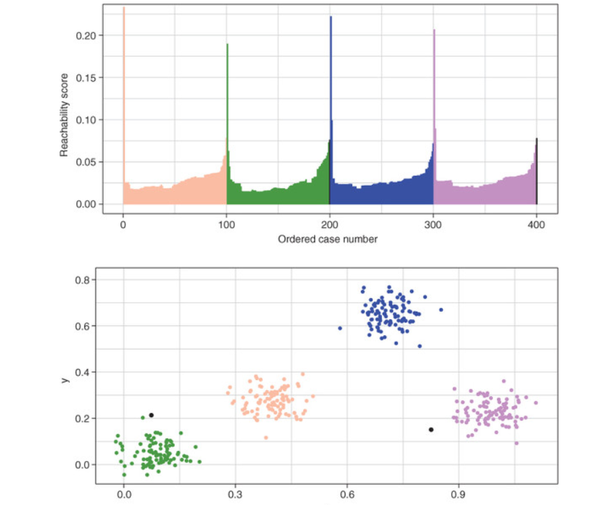
OPTICS Clustering
Based on reachability: OPTICS calculates the reachability distance for each data point, which measures the density around that point.
Reachability plot: OPTICS generates a reachability plot that can be used to visually identify clusters and noise.
Cluster extraction methods: OPTICS provides various methods for extracting clusters, including the Xi-steep method and DBSCAN-like extraction.
Parameters: OPTICS has several parameters, including min_samples, max_eps, and xi, which control the clustering behavior.
Scalability: OPTICS can be computationally expensive for large datasets, but it is generally faster than DBSCAN for variable density clustering.
Compare OPTICS and DBSCAN: Consider reviewing both algorithms' documentations and comparing their strengths and weaknesses before choosing which method is best suited for your specific data analysis task.
Visualize the reachability plot: This can be a helpful tool for understanding the clusters and noise in your data.
Experiment with different parameters: The performance of OPTICS can be sensitive to the choice of parameters. Experiment with different values to find the best results for your specific data
OPTICS can identify clusters with varying densities, while DBSCAN requires a fixed density threshold.
Automatic cluster extraction: OPTICS automatically extracts clusters based on the reachability plot, eliminating the need to manually specify density parameters.
Noise detection: OPTICS can still identify noise points, similar to DBSCAN.

Slide 7
THANK YOU
Manikandan p
manipm799339@gmail.com

